Slide 1

Satellite Systems and Design
“Architecture of On-Board Systems”
By Peter Davidsen
Systems Engineer, TERMA

Slide 2
Satellite Systems and Design
Architecture of On-Board Systems
Presentation Structure
Who am I?
On-Board Systems, Tasks and Architecture
  Focus on On-Board Computer
Interfaces
Timing Concept
Redundancy Philosophy
Hardware Design Flow
Ørsted Case
Rømer Case
CubeSat Case

Slide 3
Architecture of On-Board Systems
Who am I?
Name: Peter Davidsen
Age: 32
Education: Civilingeniør E, 1993, DTU
Experience: 8 years in the Space Industry
  Ørsted subsystem designer (CPD)
  Ørsted systems engineer
    Test and validation
    Launch and Operation
  Rømer lead systems engineer (Platform)
  Terma Star Tracker lead systems engineer
Contact, and don’t hesitate to do so!!!!
pd@terma.com

Slide 4
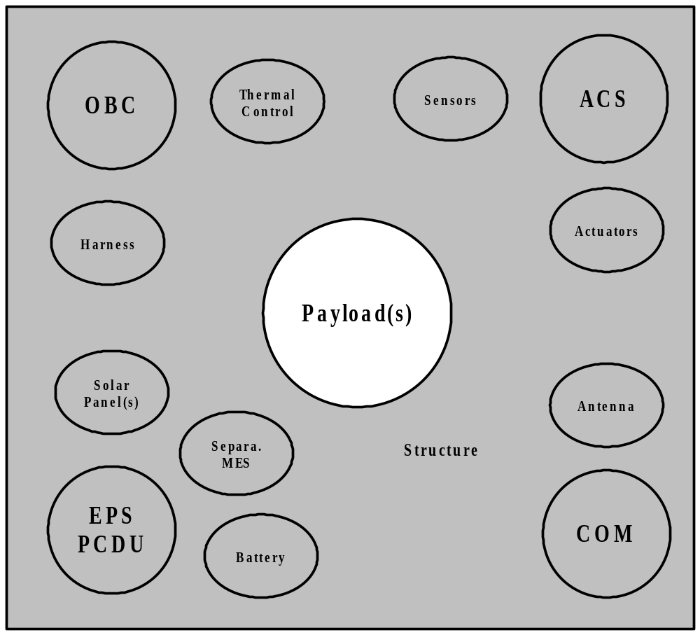
Architecture of On-Board Systems
On-Board Systems, Tasks and Architecture
Satellite on-board systems
Functions indicated
How shall these functions be implemented?
How shall they be linked together? (Interfaces)
What kind of tasks are assigned to each function?

Slide 5
Architecture of On-Board Systems
On-Board Systems, Tasks and Architecture
Electrical Power Subsystem (EPS)
  Power Control and Distribution Unit (PCDU)
  Solar panel(s)
  Battery (peak power, orbit eclipse)
PCDU
  Solar panel(s) and battery management (BCR or MPPT)
  Centralized or de-centralized DC/DC converters
  User switches and protection
  Housekeeping and protection
  Control and OBC interface
  AUX converter (internal power supply)

Slide 6
Architecture of On-Board Systems
On-Board Systems, Tasks and Architecture
On-Board Computer
Command and Data Handling (CDH)
  Receive, process and distribute telecommands from ground
  Collect science data
  Collect housekeeping and report telemetry
  Telemetry storage in mass memory
  Forward telemetry to ground
  Satellite autonomous control and monitoring (e.g. safe mode, time tagged commands...)
  Timing reference and correlation
Autonomous attitude control
etc. e.g. Star tracker data processing, Payload data processing…..

Slide 7
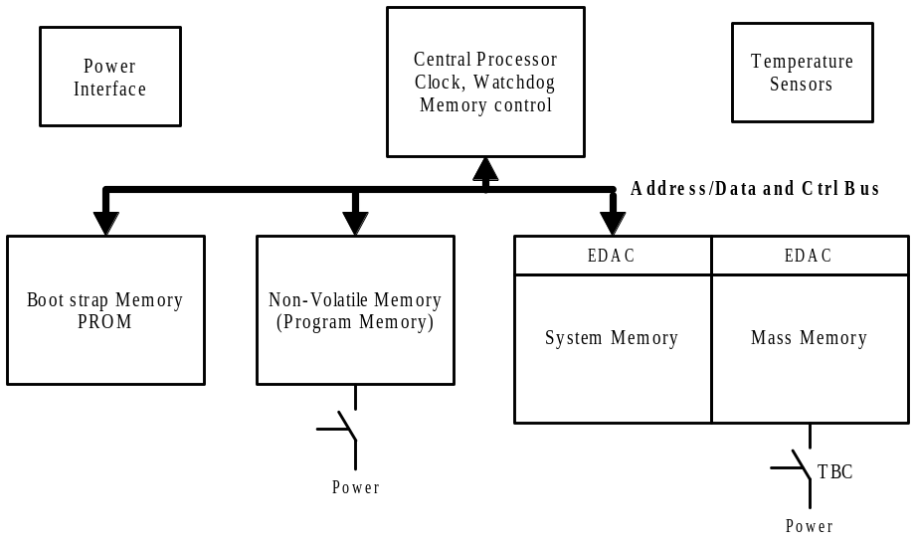
Architecture of On-Board Systems
On-Board Systems, Tasks and Architecture
OBC Core and Memory
Core
  Central processor
  System clock
  Watchdog
  Memory and interrupt control
  DMA, if needed
Memory
  Boot memory
  Non-volatile memory
  System and mass memory
  EDAC
    Single event upset mitigation (Hamming coding)
Power interface

Slide 8
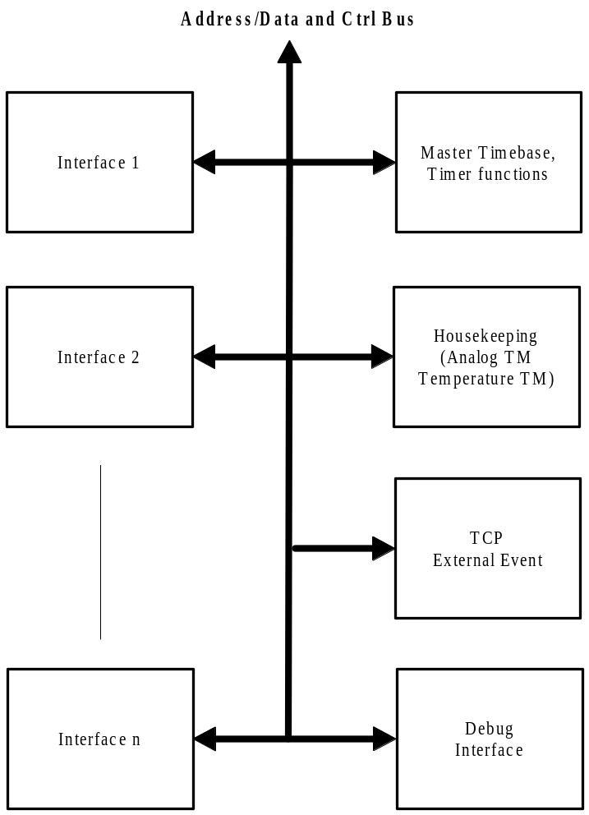
Architecture of On-Board Systems
On-Board Systems, Tasks and Architecture
OBC Peripheral Units
Interface unit 1..n
Debug interface
Master time-base and timer functions
Housekeeping circuit (V, I, T)
Discrete signal handling (I/O)
  TCP and external events
Latch-up protection (not shown)

Slide 9
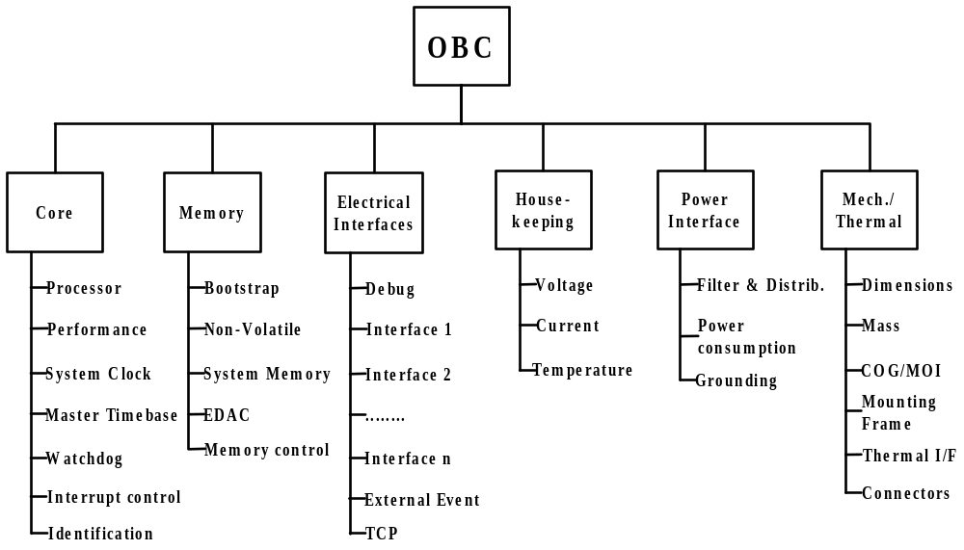
Architecture of On-Board Systems
On-Board Systems, Tasks and Architecture

Slide 10
Architecture of On-Board Systems
On-Board Systems, Tasks and Architecture
OBC Key Problem Areas
Processor selection
  Performance (MIPS and FLOPS)
  Power consumption
  Space environment
  Tools
Memory
  Technology (e.g. EEPROM/FLASH, SRAM/DRAM…)
  Power consumption
  Size (bytes)
  Space environment
  Protection
Interface implementation
  UART or FPGA
  FPGA selection (for space)
  Timing and peak load
  Protocol selection (high and low level)
  Test
Exercise: identify possible processors for the use in CubeSat OBC

Slide 11
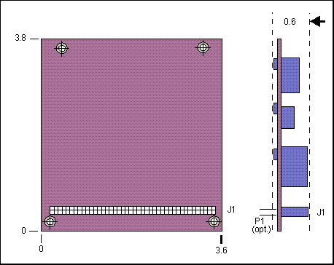
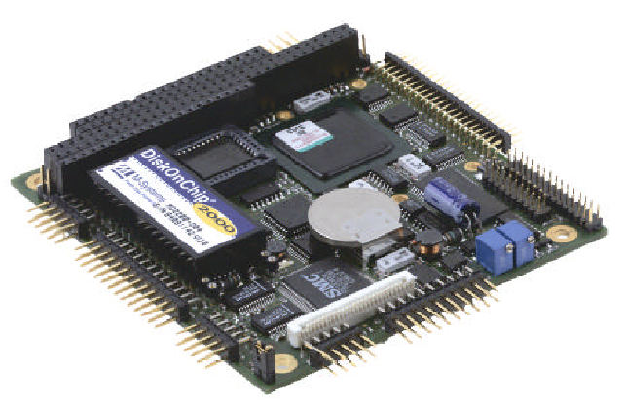
Architecture of On-Board Systems
On-Board Systems, Tasks and Architecture
OBC for CubeSat?
Consider using a PIC controller
PC104 ‘standard’, www.pc104.com
Consider ‘reverse engineering’
Look for LOW POWER and extended temperature range.
or simply GET INSPIRED!
Problem area:
Not qualified for Space, but might be used by others?

Slide 12
Architecture of On-Board Systems
On-Board Systems, Tasks and Architecture
Attitude Control Subsystem (ACS)
ACS SW part of OBC
Sensors
  Star tracker
  Rate sensors
  Magnetometer
  Sun sensors
  Earth horizon sensors
Determine sensor configuration
Select I/F to OBC
  HW
  Low and high level protocols
Actuators
  Momentum/Reaction wheels
  Magnetorquer coils/rods
    Permanent magnet
  Thruster
  Libration Damper
Determine actuator configuration
Select I/F to OBC
  HW
  Low and high level protocols

Slide 13
Architecture of On-Board Systems
On-Board Systems, Tasks and Architecture
Communication subsystem (COM)
Receiver (Rx)
  LNA
  Down converter, IF amplifier
  Demodulator
Transmitter (Tx)
  Modulator
  Solid state power amplifier (SSPA)
Duplex filter (one Rx/Tx antenna)
Antenna (S-band, VHF, UHF)
Controller
  OBC interface
  Rx/Tx mode control
  Up/down link protocol handling
    either in COM or OBC
  Coding and decoding
Housekeeping
  Essential V, I, T and Rx/Tx status
Power control and interface

Slide 14
Architecture of On-Board Systems
Interfaces
Interface Types
Electrical (HW)
Functional (SW)
Mechanical
Thermal
⇒ all this MUST BE SPECIFIED FOR ALL SUBSYSTEMS

Slide 15
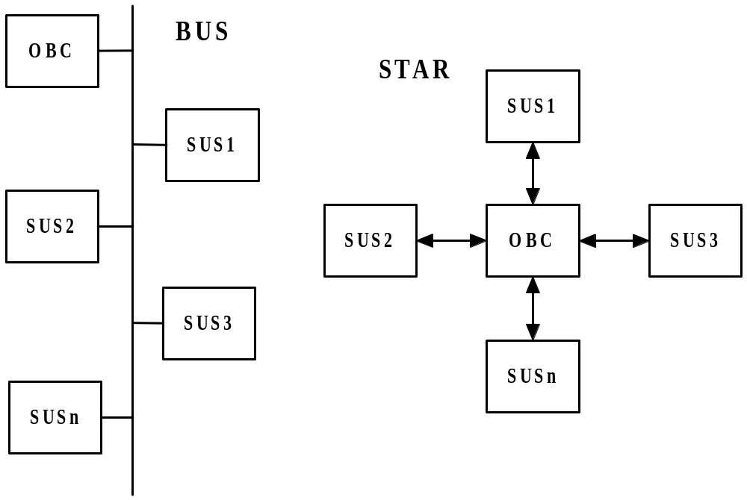
Architecture of On-Board Systems
Data Interfaces
Configuration
  Star
  Bus
Type
  Serial
  Parallel
Timing
  Asynchronous
  Synchronous
Control
  Master-Slave (MS)
  Master-Master (MM)
Exercise: List advantages and drawbacks of the Bus and Star configurations

Slide 16
Architecture of On-Board Systems
Data Interfaces
Typical interfaces
  RS422 (Star, serial, async/sync, MS/MM)
  RS485 (Bus, serial, async, MS/MM)
  PASTE (Star/Bus, parallel, sync, MS)
  CAN (Bus, serial, async, MM)
  Mil-Std-1553 (Bus, serial, async, MM)
  …..
Avoid using to many I/F configurations and types !!!!!
Exercise: CubeSat interface brainstorming

Slide 17
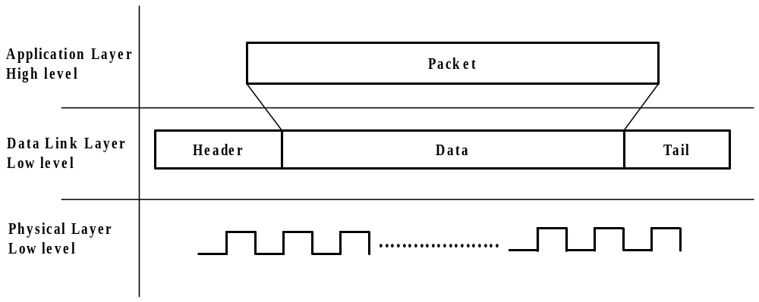
Architecture of On-Board Systems
Data Interfaces
Interface Protocol
High level
  Application layer
Low level
  Data link layer
  Physical layer

Slide 18
Architecture of On-Board Systems
Data Interfaces
High level, e.g. Packet Utilization Standard
Low level, e.g. CAN, radio link
Note, some I/F standards include only electrical properties (e.g. RS422 and RS485), other also low level protocol (e.g. CAN and 1553).
Protocol standards
Use a standard low level protocol on the up/down link
  Re-use ground station
Use standard or non-standard between OBC and SUS

Slide 19
Architecture of On-Board Systems
Data Interfaces
Data Flow Analysis
Inter Satellite (OBC to subsystems)
Ground/Satellite link
Ground data distribution
⇒
Interface bandwidth requirements including up/down link
Interface peak loads
OBC mass storage (if implemented)

Slide 20
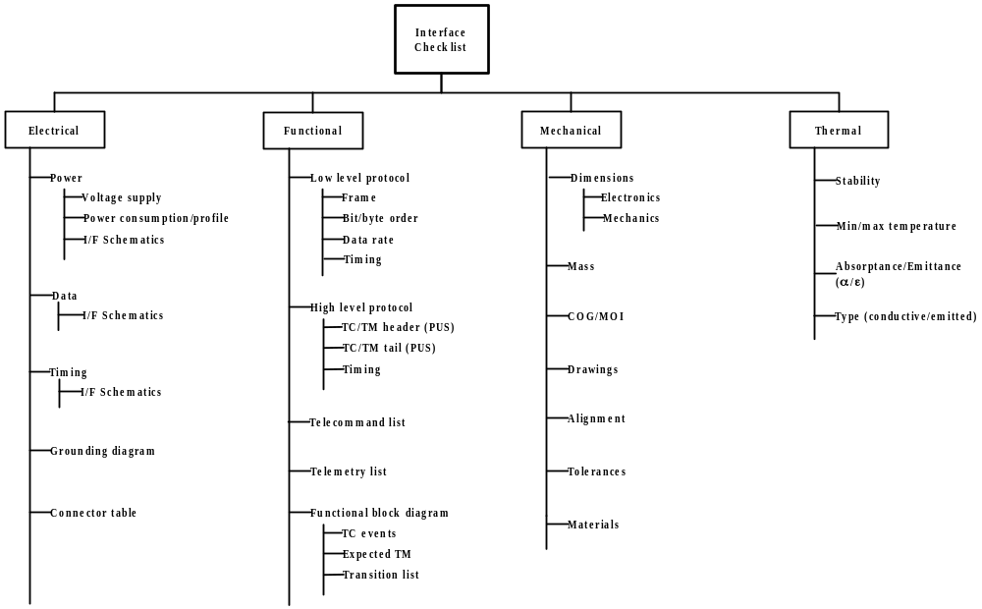
Architecture of On-Board Systems
Interface Control Document

Slide 21
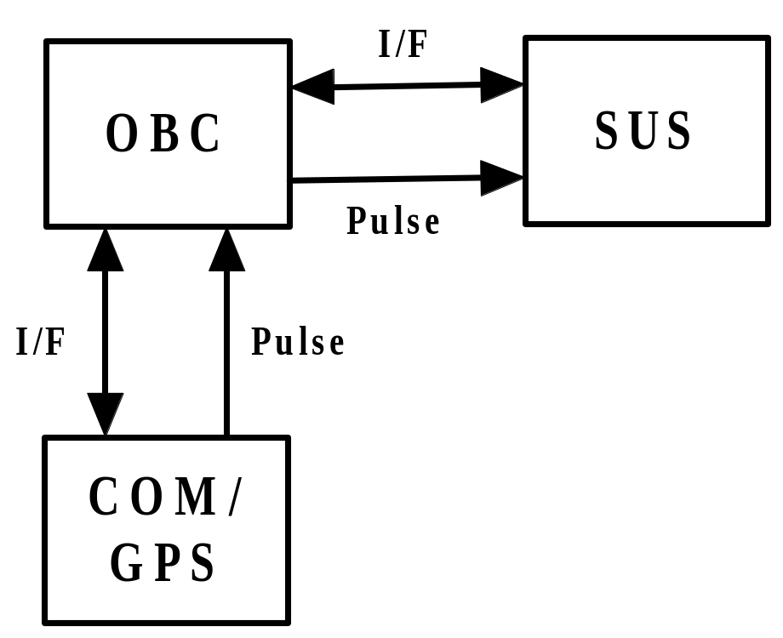
Architecture of On-Board Systems
Timing Concept
Relative time correlation
    OBC to subsystem
Absolute time correlation
    OBC to GPS
    OBC to Ground
Both principles rely on local time stamping of the signal “pulse”, followed by interchange of timestamp.

Slide 22
Architecture of On-Board Systems
Redundancy Philosophy
Introduction to Redundancy
Redundancy is used to increase satellite/subsystem reliability
Redundancy can be applied on:
    system level
    subsystem level (e.g. two OBCs, interface cross-coupling)
    subsystem internal (e.g. double boot PROMs)
Redundancy can be implemented as ‘hot or cold’
Typical problems when introducing redundancy
    increase in system complexity + mass, power and volume
    will the reliability be increased at all?
    test
    cost

Slide 23
Architecture of On-Board Systems
Redundancy Philosophy
Redundancy Roadmap
Baseline minimum configuration that satisfies the mission requirements
Evaluate reliability of each subsystem for a give lifetime and orbit
Evaluate complexity of making a subsystem redundant
Evaluate cost of making a subsystem redundant
Then decide
  Hot or Cold?
  Interface cross strapping?
Other constraints: mass, volume, power etc.
⇒ decide on redundancy concept
Exercise: CubeSat = Single String why?

Slide 24
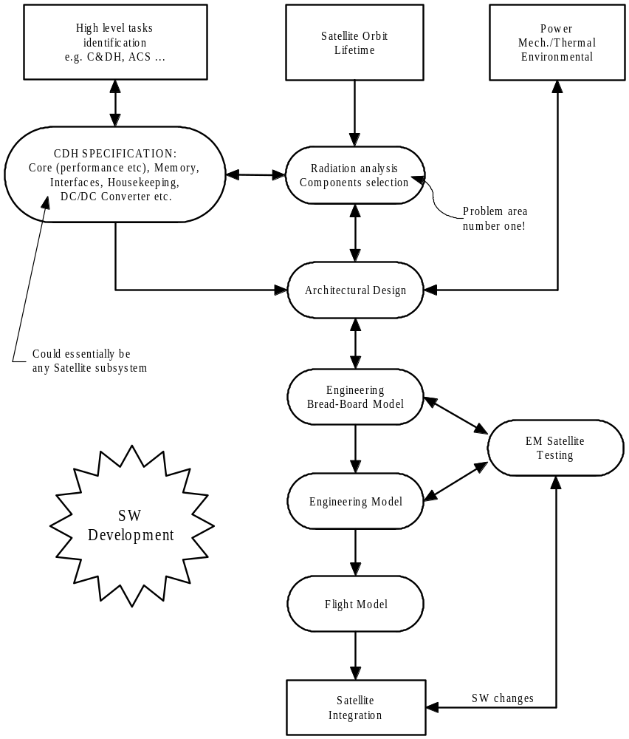
Architecture of On-Board Systems
Hardware Design Flow
HW design, step-by-step
Input
  High level tasks
  Radiation environment (given the orbit, lifetime and epoch)
  Max power, mass, envelope etc.
  External interface requirements
    Power and data
Output
  Specification
  Component selection
  Architectural design
  Detailed design

Slide 25
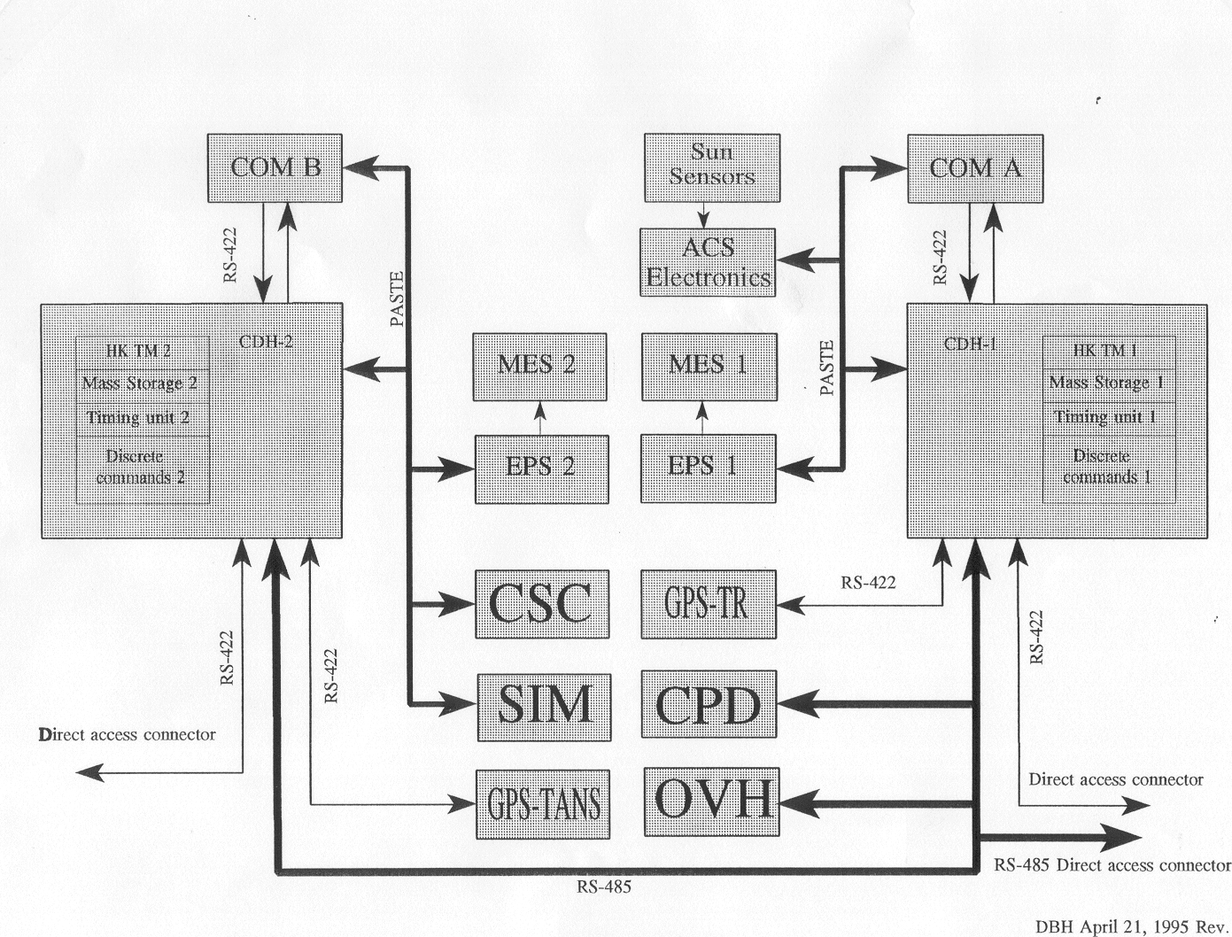
Architecture of On-Board Systems
Ørsted case

Slide 26
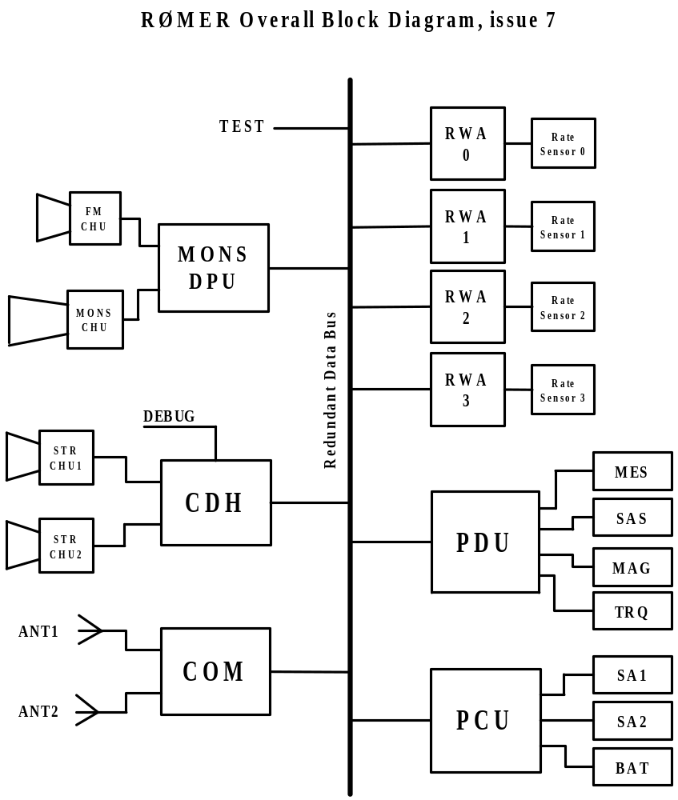
Architecture of On-Board Systems
Rømer Case
Note:
Single String Satellite
Single Payload
CDH Combines:
  Command and Data Handling
  ACS Computer
  Star Tracker Computer
‘Intelligent’ COM, EPS and Payload
Common Data Bus (CAN)
Easy Test Access
‘Simple Subsystems’ accessed through PDU

Slide 27
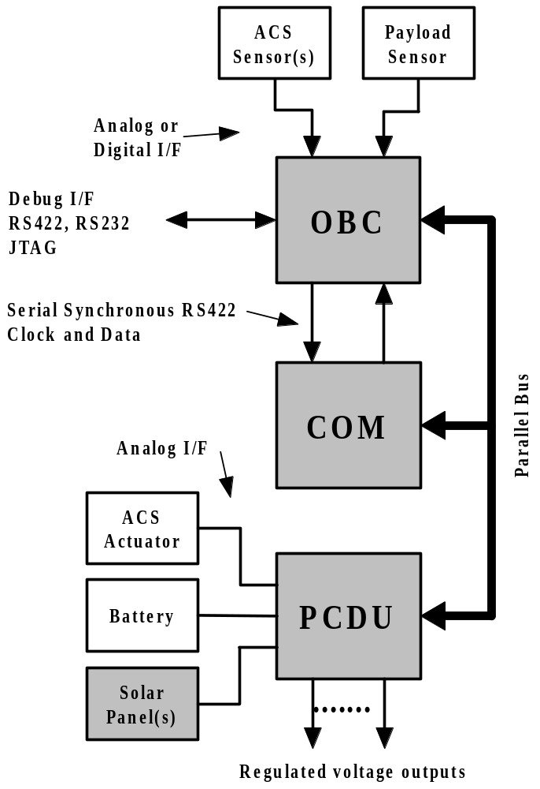
Architecture of On-Board Systems
CubeSat Case
CubeSat Block Diagram
Gray boxes indicate ‘need to be’
2’nd priority
  Battery
  Payload sensor
  ACS actuator
  ACS sensor(s)
No direct redundancy
OBC tasks
  C&DH
  Up/Down link protocol handling
  ACS data processing
  PCDU high level control
  Payload data processing

Slide 28
Architecture of On-Board Systems
CubeSat Case
CubeSat, recommendation
Limit you ambitions!
  ≤ 1 Payload
Keep it simple!
  Is ACS necessary?
Keep constant track of engineering budgets (mass, power, volume)
Implement a simple satellite safe mode:
  Radio beacon
  Non essential loads OFF
  Make it possible to change OBSW
Use simple COM (amateur radio)
  UHF/VHF, COTS unit
  Standard protocol
Use a centralized DC/DC converter
Include battery (peak power)
Consider deployable solar panels
Due to the tight engineering budgets ⇒ COTs components/subsystems (e.g. PC104 as OBC)
Pay attention to the thermal design
Use simple interfaces AND simple protocols.
Implement a direct access debug interface to the OBC used during ground tests
Test, Test and Test

